Slide 1



Dynamics 365 FastTrack Architecture Insights
Power Platform & Dataverse Security Strategy Best Practices
Henry Jammes
Principal FastTrack Solution Architect
/in/henryjammes
@HenryJammes
Notes:
Welcome to a new episode of Dynamics 365 FastTrack Architecture Insights.
This session’s topic is Security Strategy Best Practices in the Power Platform and Dataverse.
I’m Henry Jammes, Principal Solution Architect in the FastTrack team.

Slide 2

Agenda
Introduction
Regulation & Compliance
Identity Management
Power Platform security
Environment security
Security modeling in Dataverse
Impact on reporting
Resources
Notes:
This presentation covers many aspects of security: From a high-level perspective first, with regulation & compliance, identify management in Azure Active Directory to Power Platform controls, environment security and then to security modeling in Dataverse.
The goal isn’t to get into feature details but rather to provide an overview of available controls, resources, as well as best practices to secure your implementation.

Slide 3
Introduction
Notes:
Introduction

Slide 4
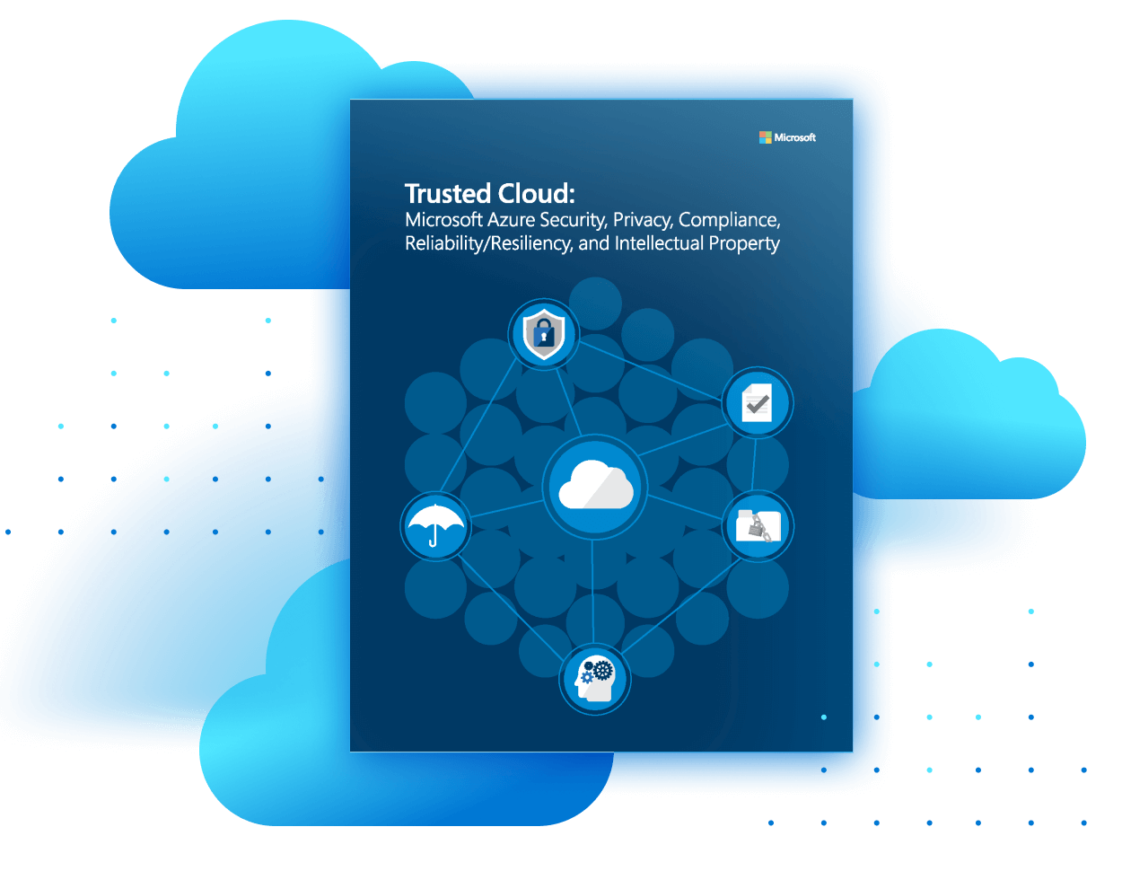
Security controls should enable appropriate use of data, not just block users.
When putting protections in place, you should be clear what threats you’re addressing.
Being clear on what concerns you’re addressing is crucial to evaluate the value and effectiveness of security investments.
Power Platform Governance and Security
Notes:
Before diving into individual capabilities, it’s important to remember that security controls should be put in place to enable an appropriate use of data.
It’s about empowering users in a governed and secure way. Not just blocking users from being productive.
So, when putting protections in place, you should be clear what threats you’re looking to address.
Being clear on what concerns you’re addressing is crucial to evaluate the value and effectiveness of security investments.

Slide 5





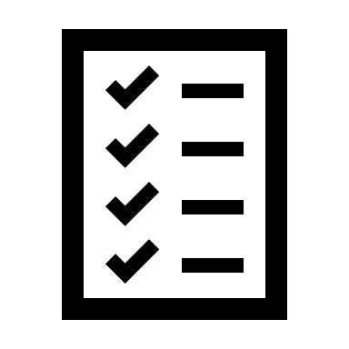






Power Platform Pillars of Trust
Data
Encryption
Data
Privacy
MANAGE
MONITOR
Compliance
Data
Loss Prevention
Security
Government
Hosting
Governance
POWER PLATFORM
Azure
Identity
Management
Compliance
Standards
Unified
Administration
System
Health
API Automation
& DevOps
CoE &
Best Practices
Usage
analytics
Activity
Logging
Notes:
The Power Platform is built on top of Azure.
Being part of Azure means that we are offering an uncompromising commitment to privacy. It’s your data, empowering your experiences, and it’s controlled by you.
Security is foundational for Azure, and the Power Platform takes advantage of multilayered security investments provided across physical datacenters, infrastructure, operations, cybersecurity and data compliance.
Azure has more than 90 compliance offerings.
This allows the Power Platform to effectively support standards like GDPR, FedRAMP, and more.
On top of that, the Power Platform has additional governance capabilities like resource management and monitoring, making it simple to set up proper guardrails for enterprise scale rollout of the low-code platform.
The Power Platform has native Azure Active Directory integration, and benefits from encryption capabilities for data at rest and in-transit.
Lastly, the Power Platform offers management and monitoring capabilities.

Slide 6


If you are a commercial or public sector customer in the EU, we will go beyond our existing data storage commitments and enable you to process and store all your data in the EU.
This plan includes any personal data in diagnostic data and service-generated data, and personal data we use to provide technical support.
We will also extend technical controls such as Lockbox and customer-managed encryption for customer data across Microsoft core cloud services.
Brad Smith
Microsoft President and Chief Legal Officer
Answering Europe’s Call: Storing and Processing EU Data in the EU: https://blogs.microsoft.com/eupolicy/2021/05/06/eu-data-boundary/
Notes:
In 2021, Brad Smith, Microsoft President and Chief Legal Officer, made a commitment to European customers that actually apply to all customers.
This related to where your data (personal data, diagnostic data, service-generated data) is stored in terms of geography, but also related to the availability of technical controls, such as Lockbox and customer managed keys, to further secure your data.

Slide 7
Regulation & Compliance
Notes:
Regulation & Compliance

Slide 8



Regulation & compliance security strategy
Understand how regulatory requirements impact your applications
Validate that Microsoft and your implementation comply with regulatory requirements for data security
Microsoft complies with data protection and privacy laws applicable to cloud services. Our compliance with world-class industry standards is verified.
Learn more on the Microsoft Trust Center: https://www.microsoft.com/trust-center/compliance
Understand where your data is located and the impact on regulatory requirements
Environments can be created in specific regions, even if different from the region the tenant resides in.
Learn more on data location: https://www.microsoft.com/trust-center/privacy/data-location
Review available Data Protection Resources
Discover how Microsoft cloud services protect your data, and how you can manage cloud data security and compliance for your organization. This also includes the latest penetration test and security assessments.
Learn more on the Service Trust Portal: https://servicetrust.microsoft.com/ViewPage/TrustDocumentsV3 Learn more on Penetration Testing Rules of Engagement: https://www.microsoft.com/msrc/pentest-rules-of-engagement
Notes:
It’s critical that you understand how regulatory requirements impact your applications.
So, you should:
Validate that Microsoft and your implementation (i.e., your use of out-of-the box features or your customizations) comply with regulatory requirements for data security. You can use the Microsoft Trust Center for more information.
Understand where your data is located and the impact on regulatory requirements In multi-geo configurations, you can create environments in regions that are different from the region your tenant resides in.
Review available Data Protection Resources such as the latest penetration test reports on the Microsoft Service Trust Portal.

Slide 9
Identity Management
Notes:
Identity Management

Slide 10



Identity security strategy
Securing user access and devices
Secure how users access services using their Azure Active Directory identities
Implement strong multi-factor authentication to safeguard user credentials
Learn more on Azure AD Multi-Factor Authentication: https://docs.microsoft.com/azure/active-directory/authentication/concept-mfa-howitworks
Make sure that the services are accessed under compliant conditions
Apply context-based adaptive policies to grant, limit, or block access, based on device, location, IP, etc.
Learn more on Azure AD Conditional Access: https://docs.microsoft.com/azure/active-directory/conditional-access/ https://docs.microsoft.com/power-platform/admin/restrict-access-online-trusted-ip-rules https://docs.microsoft.com/power-platform/guidance/adoption/conditional-access https://docs.microsoft.com/azure/active-directory/conditional-access/concept-continuous-access-evaluation
Store and manage application credentials such as secrets, keys, and certificates in a key vault
Avoid storing these in code or in configuration tables. When possible and available, leverage managed identities.
Learn more on Azure Key Vault https://docs.microsoft.com/azure/key-vault/general Learn more on Azure AD managed identities https://docs.microsoft.com/azure/active-directory/managed-identities-azure-resources
Notes:
Securing user access and devices is fundamental.
You can dramatically reduce the risk of identity theft with multi-factor authentication in Azure Active Directory.
Accessing to sensitive personal or business data should only happen under compliant conditions (for example from specific locations, from managed and up-to-date devices with an active anti-virus, etc.). Azure AD Conditional Access can help reduce the risk of compromised data.
Application credentials should be stored in a key vault such as Azure Key Vault and not in code or in configuration tables. When possible and available, leverage managed identities in your architecture.

Slide 11



Privileged accounts security strategy
Securing, limiting and monitoring usage of users and services with elevated privileges
Understand privileged roles in Microsoft 365 and the Power Platform
Microsoft 365 roles: Global administrator, Power Platform administrator, Dynamics 365 administrator. Power Platform environment security roles: System Administrator, System Customizer, Environment Maker.
Learn more on Microsoft 365 (Azure AD) and Power Platform environment roles: https://docs.microsoft.com/power-platform/admin/use-service-admin-role-manage-tenant https://docs.microsoft.com/power-platform/admin/database-security
Limit and regularly review the list of elevated user and service accounts Consider a Just-In-Time (JIT) access approach to grant elevated privileges Consider administrative users to grant access to settings and administration features but not to functionality
Learn more on Privileged Identity Management in Azure AD and Administrative User in the Power Platform https://docs.microsoft.com/azure/active-directory/privileged-identity-management https://docs.microsoft.com/power-platform/admin/prevent-elevation-security-role-privilege https://powerapps.microsoft.com/blog/building-a-jit-app-for-elevated-permissions-on-microsoft-power-platform
Use Azure AD applications and service principals for integration and deployment
Server-to-server (S2S) authentication allows secure and seamless communication between applications and services.
Learn more on applications, service principals, in Azure AD and Power Platform https://docs.microsoft.com/azure/active-directory/develop/howto-create-service-principal-portal https://docs.microsoft.com/power-platform/admin/manage-application-users
Notes:
It’s also crucial to secure, limit and monitor the usage of users and services with elevated privileges.
That means:
Understanding and securing privileged accounts, such as accounts with a Microsoft 365 administrator role or users with a system administrator security role in Dataverse, especially if the environment contains production or personal data.
Considering a Just-In-Time access approach to grant elevated privileges only when are they needed.
Avoid user accounts for integration and deployment, by using Azure AD applications and service principals instead.

Slide 12
Power Platform security
Notes:
Power Platform security

Slide 13




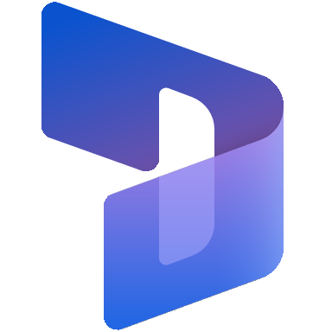


Single versus multi-tenant strategy
Multi-tenancy means separate Microsoft 365 / Azure AD Tenants
Benefits of multi-tenant
Global businesses with regional or country models that differ can use tenants to account for variations in approach, market size, or compliance with legal and regulatory constraints.
Considerations
User accounts, identities, security groups, subscriptions, licenses, environments and storage cannot be shared among tenants.
Interaction and collaboration are, in most cases, expected and designed to be within a tenant. Some features aren’t available for guest users.
A single domain can only be federated with one tenant.
Contoso Tenant
U.S.
Contoso Tenant
Japan
Users
Security Groups
Subscriptions
Users
Security Groups
Subscriptions
Sales & Marketing
Customer Service
Sales & Marketing
Inventory
Storage
Storage
Learn more on multiple tenants and environments: https://docs.microsoft.com/power-platform/admin/multiple-online-environments-tenants
Notes:
From a tenant perspective, the highest level of isolation can be achieved by having a multi-tenant strategy.
Tenants can contain many environments, and each environment can contain many applications.
This however comes with a number of considerations and limitations, as everything (user accounts, identities, security groups, subscriptions, licenses, environments, storage, etc.) would have to managed per tenant.
Many features are also limited in cross-tenant collaboration scenarios.

Slide 14



Power Platform tenant controls
Securing citizen developer and production applications and automations
Create data loss prevention (DLP) policies to enable data use and control inadvertent use or exploitation.
DLP policies offer connector action granularity, endpoint filtering, and can be scoped at the environment or tenant level, to strike the right balance between protection and productivity. So, secure DLP policies can automatically apply to citizen developer environments while other DLP policies apply to production workloads.
Learn more on data loss prevention policies: https://docs.microsoft.com/power-platform/admin/wp-data-loss-prevention
Evaluate cross-tenant inbound and outbound restrictions
With tenant restrictions, organizations can control access to SaaS cloud applications – based on the Azure AD tenant the applications use for single sign-on – and can specify the list of tenants that their users are permitted to access.
Learn more on tenant isolation: https://docs.microsoft.com/power-platform/admin/cross-tenant-restrictions
Assess email exfiltration controls
Microsoft Power Platform has the capability to insert specific SMTP headers in email messages sent through Power Automate and Power Apps to block exfiltration of forwarded emails
Learn more on email exfiltration controls: https://docs.microsoft.com/power-platform/admin/block-forwarded-email-from-power-automate
Notes:
The Power Platform offers tenant controls to strike the right balance between protection and productivity:
Data loss prevention (DLP) policies, to enable data use and control inadvertent use or exploitation. DLP policies offer connector action granularity, endpoint filtering, and can be scoped at the environment or tenant level. DLP policies can automatically apply to citizen developer environments while other DLP policies apply to production workloads.
Cross-tenant restrictions, so that organizations can control access to SaaS cloud applications and can specify the list of tenants that their users are permitted to access.
Email exfiltration controls, to insert specific SMTP headers in email messages sent through Power Automate and Power Apps to block exfiltration of forwarded emails.

Slide 15


Power Platform monitoring controls
Auditing sensible data and user actions, and monitoring application telemetry and usage
Leverage auditing and logging controls available in Microsoft 365 and Microsoft Dataverse
When enabled and configured, these features allow to record and review data updates and user actions.
Learn more on Dataverse audit mechanisms, Microsoft 365 compliance center audit logs https://docs.microsoft.com/power-platform/admin/audit-data-user-activity https://docs.microsoft.com/power-platform/admin/enable-use-comprehensive-auditing
Integrate with Microsoft Sentinel
Microsoft Sentinel is a scalable, cloud-native, security information event management (SIEM) and security orchestration automated response (SOAR) solution for alert detection, threat visibility, proactive hunting, and threat response.
Learn more on Microsoft Sentinel https://docs.microsoft.com/azure/sentinel/connect-dynamics-365
Monitor usage and application telemetry
Reports and configurable export options provide insights on Power Platform usage, performance and diagnostics data.
Learn more on Azure Application Insights integration: https://docs.microsoft.com/power-platform/admin/overview-integration-application-insights Learn more on Power Apps tenant-wide analytics: https://docs.microsoft.com/power-platform/admin/tenant-level-analytics Learn more on Power Automate analytics https://docs.microsoft.com/power-platform/admin/analytics-flow Learn more on exporting usage and inventory data to an Azure Data Lake: https://docs.microsoft.com/power-platform/admin/self-service-analytics Learn more on the Center of Excellence starter kit: https://docs.microsoft.com/power-platform/guidance/coe/starter-kit
Notes:
The Power Platform, Microsoft 365 and Microsoft Sentinel offer several auditing and monitoring capabilities.
Auditing controls available in Microsoft 365 and Microsoft Dataverse allow to track user actions, changes to security roles, updates made to records, as well as Excel export and read operations, among other things.
Data stored in Microsoft 365 compliance center audit logs can be integrated with Microsoft Sentinel, a scalable, cloud-native, security information event management (SIEM) and security orchestration automated response (SOAR) solution for alert detection, threat visibility, proactive hunting, and threat response.
Usage data as well as inventory data, performance and diagnostic data are available, and the Center of Excellence starter kit can be used to monitor, govern and improve adoption.

Slide 16



Power Platform data controls
Securing data, data labeling, and managing data access requests
Review your Power Platform environments encryption
All environments of Microsoft Dataverse perform real-time encryption of data, at rest and in-transit. By default, Microsoft stores and manages the encryption key, but under eligible conditions, admins can choose to self-manage it.
Learn more on using customer-managed keys: https://docs.microsoft.com/power-platform/admin/manage-encryption-key
Scan, classify, and label Dataverse data with Azure Purview 💡 planned
Azure Purview is a unified data governance service that helps you manage and govern your data, with automated data discovery, sensitive data classification, and end-to-end data lineage.
Learn more on Azure Purview: https://docs.microsoft.com/azure/purview/overview Learn more on Microsoft Information Protection: https://docs.microsoft.com/microsoft-365/compliance/information-protection
Enable Lockbox policies for your Power Platform environments 💡 planned
Lockbox provides an interface to review – and approve or reject – data access requests, typically in the context of a support request. After access is granted to Microsoft, any customer data access during the elevated access period is recorded and made available as audit logs.
Notes:
There are also a few additional options related to data security in the Power Platform.
Dataverse data is by default encrypted at rest using rotating Microsoft-managed keys. This should be sufficient for most customers, but under eligible conditions to address specific requirements, administrators can choose to self manage the encryption keys.
Support from Microsoft Information Protection and Azure Purview is planned, so you will be able to have the MIP labels on your data, have them flow through the connectors inside of Power Apps, and also have it be associated with all the data stored inside of Dataverse.
Support for Lockbox is also planned for the Power Platform, so administrators will have an interface to review – and approve or reject – data access requests, typically in the context of a support request.

Slide 17



Power Platform network controls
Securing how your services and data are accessible over public or private networks
For specific network requirements, consider Azure ExpressRoute with Microsoft Power Platform
Azure ExpressRoute provides a way to connect your on-premises network to Microsoft cloud services by using private connectivity. This is useful when you need to make sure your network or internet connection can handle additional traffic; to manage the predictability of traffic; or to ensure data never transits across the public internet.
Configuring ExpressRoute for Power Platform services requires Microsoft peering. This means that the traffic will be routed to go to Power Platform public IP address ranges (and BGP communities are not supported).
Learn more on using Azure ExpressRoute with the Power Platform: https://docs.microsoft.com/power-platform/guidance/expressroute/overview
Leverage Azure Networking Connectivity 💡 planned
Connect from the Power Platform into your Azure Virtual Network.
For complex architectures with multiple integrations, consider using API gateways
With Azure API Management (APIM), you can deploy API gateways side-by-side with the APIs hosted in Azure, other clouds, and on-premises, optimizing API traffic flow. APIM also allows to publish backend service as APIs and export these to the Power Platform as custom connectors.
Learn more on Azure API Management: https://docs.microsoft.com/azure/api-management/ https://docs.microsoft.com/azure/api-management/export-api-power-platform
Notes:
There are also a few options you can consider for network security in the Power Platform.
For very specific scenarios, you can setup Azure ExpressRoute with Microsoft Power Platform. This can be useful when you need to ensure data never transits across the public internet. Today, this requires Microsoft peering and doesn’t support private peering. This means that the traffic will be routed to go to Power Platform public IP address ranges.
Azure networking connectivity is planned for the Power Platform. When available, this will make it so that you can go connect from the Power Platform into your Azure virtual network, and leverage things like ExpressRoute or Gateways, so all of your investments for networking with Microsoft will carry over seamlessly to the Power Platform.
For complex architectures with multiple integrations, you should consider using Azure API Management as an API Gateway. API gateways can be deployed side-by-side with the APIs hosted in Azure, other clouds, and on-premises, optimizing API traffic flow. Azure API Management also allows to publish backend service as APIs and export these to the Power Platform as custom connectors.

Slide 18
Environment security
Notes:
Environment security

Slide 19
Single versus multi-environment strategy
Having separate environments allows to logically segregate users and data in silos
Data & Compliance
Security Requirements
Autonomous Business Units
Geographically Dispersed
Latency
Benefits of multi-environment
Environments can be in different regions.
Simpler administration, with distinct security groups for each environment.
Users can access multiple environments, across geographies, in a tenant.
Simpler management of localizations & customizations to meet business lines requirements.
More ALM granularity for solution deployment.
Considerations
Storage is shared, totaled and tracked across all environments collectively.
Additional complexity to deploy customizations and update applications across environments.
Additional complexity to share and synchronize data across environments.
Learn more on multiple tenants and environments: https://docs.microsoft.com/power-platform/admin/multiple-online-environments-tenants
Notes:
Customers can choose to deploy any number of environments in the Power Platform.
These environments typically contain a Dataverse database as well as a number of Dynamics 365 or Power Apps applications.
There are a few benefits to go for a multi-environment strategy:
Environments can be in different regions and users can access multiple environments, across geographies, in a tenant.
Administration can be simplified, with distinct security groups for each environment.
Management of localizations and customizations to meet business lines requirements is simplified as there is more latitude and autonomy to manage those.
There is also more ALM granularity when it comes to deployment.
There are also a few considerations to keep in mind:
Storage is shared and tracked across all environments collectively. Having more environments generally consume more storage.
Deploying customizations and updating applications across multiple environments require more efforts than update a single one.
Sharing and synchronizing data across environments can also require additional work.

Slide 20



Environment security strategy
Secure your Microsoft Dataverse environments
Assess if your environments should be visible to all users or not
You can associate an AAD security group with an environment to limit access to the group members.
Learn more on controlling user access to environments https://docs.microsoft.com/power-platform/admin/control-user-access
Understand environment system and manual backups
System backups for production environments that have been created with a database and have one or more Dynamics 365 applications installed are retained for up to 28 days. For others, 7 days.
Learn more on backing up and restoring environments https://docs.microsoft.com/power-platform/admin/backup-restore-environments
Evaluate need for data archival and retention policies 💡 planned
Move Dataverse data to long-term storage to support regulatory requirements, internal and external audit requirements, and reduce non-active data from the transactional store.
Have representative noncustomer data for test sets in non-production environments
Avoid using customer personal and business confidential data in non-production environments. If performing production environment copies, consider implementing processes to obfuscate sensitive data.
Notes:
There are a few security options at the environment level that you should consider:
First is to assess if your environment should be visible to all users or not. Typically, development or test environments aren’t useful to your application end-users. You can associate an Azure AD security group with an environment to limit access to the members of the group.
All environments are automatically backed up and a previous point in time version of the environment can be restored. For production environments that have been created with a database and have one or more Dynamics 365 applications installed, backups are retained for up to 28 days. For others, 7 days.
Support for data archival and retention policies is coming and will allow administrators to move Dataverse data to long-term storage, to support regulatory requirements, internal and external audit requirements, and reduce non-active data from the transactional store.
Last, to further secure production confidential or personal data, we advise to have representative noncustomer data for test sets in non-production environments. This is to avoid using customer personal and business confidential data in non-production environments, where users typically have elevated privileges (e.g., developer with a system administrator security role).

Slide 21
Security modeling in Dataverse
Notes:
Security modeling in Dataverse

Slide 22



Dataverse security controls overview
From fundamental security controls to exception management
Manually sharing records
Used to manually handle exceptions to the model.
Additional controls:
Hierarchy security
Field-level security
Access teams
Table relationships behaviors
These options allow to handle exceptions to the fundamental security controls more easily.
Fundamental security controls:
Hierarchy of business units
Security roles 💡 can now be assigned independently of the user or team’s business unit
Users and teams
Record assignment to a business unit 💡 can now be different from the record owner’s business unit
These controls generally cover most requirements.
Learn more on Dataverse security concepts: https://docs.microsoft.com/power-platform/admin/wp-security-cds
Notes:
When implementing a security model in Dataverse, you should always try to cover the requirements with some of the fundamental security controls first.
So, this the hierarchy of business units to organize users, teams and records around,
The various security roles (that can now be assigned independently of the user or team’s business unit),
The users and various team types (owner, access, Azure AD groups, etc.),
And the record assignment to a business unit (note: that the owning business unit of a record can now also be different from the record owner’s business unit).
These controls generally cover most requirements.
For other edge cases, you should also look at additional available controls:
Hierarchy security
Field-level security
Access teams
Table relationships behaviors
These options allow to handle exceptions to the fundamental security controls more easily.
The last option you should consider is sharing. It should be used to manually handle exceptions to the model.

Slide 23



Approaching a security model design
Shortly after defining personas and scopes, it’s important to define how users, teams and records will be organized around the hierarchy of business units.
Define what data you’re trying to secure
Reflect on the required granularity between organizational and confidential data.
Consider splitting data into separate tables when there is a mix of company and commercial data.
Define the hierarchy of business units
Business units shouldn’t necessarily reflect an internal organization: they define the hierarchical structure of users, teams, and records. They work in conjunction with security roles to grant access to data for specific scopes.
Define how users and teams are organized in the hierarchy of business units
In some situations, users can remain at the root business unit level while security roles scoped to other business units allow to tailor access rights to another business unit. Security roles inherited from teams also allow rich setups.
Define how records are organized in the hierarchy of business units
By default, records belong to their owner’s business unit. This can be overridden by changing the “Owning Business Unit” column of a table, so that records can be assigned to a business unit irrespective of their owner’s.
Notes:
Shortly after defining personas and scopes, approaching a security model design should be done by defining how users, teams and records will be organized around the hierarchy of business units.
So, first, you should define what data you’re trying to secure: reflect on the required granularity between organizational and confidential data. To ease your model, you can consider splitting data into separate tables when there is a mix of company and commercial data.
When defining the hierarchy of business units, always keep in mind that they shouldn’t necessarily reflect an internal organization: they define the hierarchical structure of users, teams, and records. They work in conjunction with security roles to grant access to data for specific scopes.
Then define how users and teams should be organized in the hierarchy of business units. In some situations, users can remain at the root business unit level while security roles scoped to other business units allow to tailor access rights to another business unit. Security roles inherited from teams also allow rich setups.
You should also define how records are organized in the hierarchy of business units. By default, records belong to their owner’s business unit. This can now be overridden by changing the “Owning Business Unit” column of a table, so that records can be assigned to a business unit irrespective of their owner’s.

Slide 24



Documenting a security model
Security model design should typically contain:
An overview of the model
With the hierarchy of business units, the necessary team constructs, security mechanisms used in the project, etc.
The different security roles
With the list of tables, privileges, and access levels. Miscellaneous privileges should also be documented (e.g., Export to Excel, Impersonation, etc.).
The list of tables used in the project, their type of ownership and how ownership will be determined
E.g., user, team or organization, what rules will determine the owner, etc.
Security automation business logic In some models, business rules are applied at the integration or application layer to help automate security.
The list of tables used in the project and their relevant relationship behaviors
This is especially important for assign, delete, reparent, share and unshare behaviors.
Notes:
Documentation is important to any project, so when designing a security model, consider the following aspects:
An overview of the model With the hierarchy of business units, the necessary team constructs, security mechanisms used in the project, etc.
The different security roles With the list of tables, privileges, and access levels. Miscellaneous privileges should also be documented (e.g., Export to Excel, Impersonation, etc.).
The list of tables used in the project, their type of ownership and how ownership will be determined E.g., user, team or organization, what rules will determine the owner, etc.
Security automation business logic In some models, business rules are applied at the integration or application layer to help automate security.
The list of tables used in the project and their relevant relationship behaviors This is especially important for assign, delete, reparent, share and unshare behaviors.

Slide 25




Security model best practices
Defining your Dataverse security model
Keep your model simple and have the future in mind
Be mindful of the required effort to maintain the security model. Anticipate the impact of reorganizations, user onboarding, user leaving or user changing roles. Try to limit the number of security patterns, security roles, business units (and their depth) and teams.
Avoid unhealthy patterns
Automated sharing at scale is never easy to maintain and can introduce scalability and performance issues. Try to cover as many scenarios as possible with simple patterns, and only resort to sharing for exceptions to the model.
Plug-ins firing on Retrieve and RetrieveMultiple events also have caveat and impact performances negatively.
Understand that customization of the user interface is different from securing data
When a user has update privileges on a record, just because a field is set as read-only on a form doesn’t mean the data can’t be updated through other means. True security resides server-side. Hiding the “Export to Excel” button doesn’t mean users can’t export the data with other tools.
That being said, security roles can and should also be leveraged to create simple role-based UX.
Assess security impacts in related applications and/or features
Evaluate access rights in satellite apps and services (e.g., Customer Insights, SharePoint, Teams, Portals, Power BI, etc.).
Notes:
There are few best practices that can be recommended when designing a security model:
Keep your model simple and have the future in mind: evaluate the potential effort to maintain the security configuration. For this, try to anticipate the impact of reorganizations, user onboarding, offboarding, or user changing roles. You should also try to limit the number of different security patterns, security roles, business units (and their depth) and teams.
Avoid unhealthy patterns. For example, automated sharing at scale is never easy to maintain and can introduce performance issues at scale. So, try to cover as many scenarios as possible with simple patterns, and only resort to sharing for exceptions to the model. Similarly, plug-ins firing on Retrieve and RetrieveMultiple events also have caveat and impact performances negatively.
Understand that customization of the user interface is completely different from securing data. For example, if a user has update privileges on a record, just because a field is set as read-only on a form doesn’t mean the data can’t be updated through other means. True security resides server-side. Similarly, hiding the “Export to Excel” button doesn’t mean users can’t export the data with other tools or through APIs. That being said, security roles can and should also be leveraged to create simple, role-based, UX.
Assess security impacts in related applications and/or features, for example in Dynamics 365 Customer Insights, SharePoint, Teams, Power Apps Portals, Power BI, etc.

Slide 26




Security roles best practices
Defining security roles for your applications
Implement a least privilege strategy when designing your security roles
Consider only providing users with what is necessary (just-enough-access – JEA) to accomplish their job by reducing read/write privileges to a user or business unit scope and avoid granting delete privileges by favoring deactivating records instead.
When possible, drive security roles assignment through Azure AD groups
Managing user roles through Azure AD group teams greatly reduces administration effort and risks of error.
Start from a copy of existing security roles and create them at the root business unit
This allows better control over the new security roles and avoids conflicts with first-party updates.
Security roles at the root business level can be included in solutions and deployed to other environments.
Be mindful of privileges potentially leading to elevated permissions
E.g., “Promote User to Microsoft Dynamics 365 Administrator Role”
Combine similar roles for easier management
You rarely need as many security roles as there are job titles.
Notes:
There are a few best practices when it comes to designing security roles in Dataverse.
Implement a least privilege strategy when designing your security roles. So, consider only providing users with what is necessary to accomplish their job by reducing read/write privileges to a user or business unit scope. You should also avoid granting delete privileges by favoring deactivating records instead.
When possible, try to drive most if not all security roles assignment through Azure AD groups This greatly reduces administration effort and risks of error.
When creating new roles, always start from a copy of existing security roles and create them at the root business unit.
Be mindful of privileges potentially leading to elevated permissions. For example, “Promote User to Microsoft Dynamics 365 Administrator Role”
Combine similar roles for easier management: you rarely need as many security roles as there are job titles.

Slide 27


Additional considerations
Processes & guidelines
Consider reporting to simplify a security model
If managers only need an overview of business (e.g., territory pipeline forecast), instead of defining a complex model on individual records, consider an anonymized report with limited access to the underlying raw data.
Monitor customizations being deployed to production
By being source control-centric and with a gated Application Lifecycle Management (ALM) approach – with code reviews and approvals of pull requests – reduce risk of deploying malicious or unsecure customizations.
Have a secure process to handle changes to data involved in sensitive operations
E.g., updating a customer phone number used for verification, should it be approved, audited? Should the customer be warned?
Consider security checks and trainings for employees accessing confidential data
Reduce risks by performing security checks and providing security trainings.
Don’t use Dataverse as a vault for highly sensitive information such as credit cards
Compliant tools and solutions should be considered instead.
Notes:
Last but not least, there are a few things you should also be mindful of when it comes to security processes and guidelines.
Consider reporting as an option to simplify a security model. For example, if managers only need an overview of the business (e.g., territory pipeline forecast), instead of defining a complex model on individual records, consider an anonymized report with limited access to the underlying raw data.
Monitor customizations being deployed to production. By being source control-centric and with a gated Application Lifecycle Management (ALM) approach – with code reviews and approvals of pull requests – you can reduce the risk of deploying malicious or unsecure customizations.
Have a secure process to handle changes to data involved in sensitive operations. For example, updating a customer phone number used for verification, should it be approved, audited? Should the customer be warned?
Consider security checks and trainings for employees accessing confidential data.
Don’t use Dataverse as a vault for highly sensitive information such as credit cards: compliant tools and solutions should be considered instead.

Slide 28
Impact on reporting
Notes:
Impact on reporting

Slide 29


Security strategy impact on reporting
Ensuring data remains secure when flowing outside of Dataverse
Have a data management strategy for all data that is stored outside of a core application.
When data is exported to external data stores, you need to apply your own security mechanism for reporting, as the Dataverse security permissions are no longer honored.
The reporting strategy should include security requirements (encryption, access controls, row level, PII) as well as data residency and retention requirements.
Learn more on how row-level security (RLS) can be used in Power BI to restrict data access for given users. https://docs.microsoft.com/power-bi/admin/service-admin-rls
Understand how and when to leverage the Power BI Dataverse connector with DirectQuery
The Dataverse connector in Power BI is based on the TDS endpoint, and this offers the following benefits:
DirectQuery support, so that the connected user’s security context is applied to retrieve data in real-time, making sure that users don’t see more data than what the Dataverse security model allows for them.
Native SQL query support can be used in Power BI interactive and paginated reports. With the CURRENT_USER function, you can filter records based on the connected user (e.g., “My accounts”).
Learn more on the Dataverse TDS endpoint and on using the Dataverse connector Power BI
https://docs.microsoft.com/powerapps/developer/data-platform/dataverse-sql-query https://docs.microsoft.com/powerapps/maker/data-platform/view-entity-data-power-bi https://docs.microsoft.com/power-query/connectors/dataverse
Notes:
When it comes to reporting, data often flows from Dataverse to other systems.
It’s important to be mindful of the security aspect of this, to be sure that users don’t get elevated access to confidential data through BI.
For data stored in “import mode” in Power BI, you can use row-level security to filter the records the report users have access to.
Another option is to use DirectQuery on top of Dataverse in Power BI. That way, the connected user’s security context is applied to retrieve data in real-time, making sure that users don’t see more data than what the Dataverse security model allows for them.

Slide 30
Resources
Notes:
Resources

Slide 31
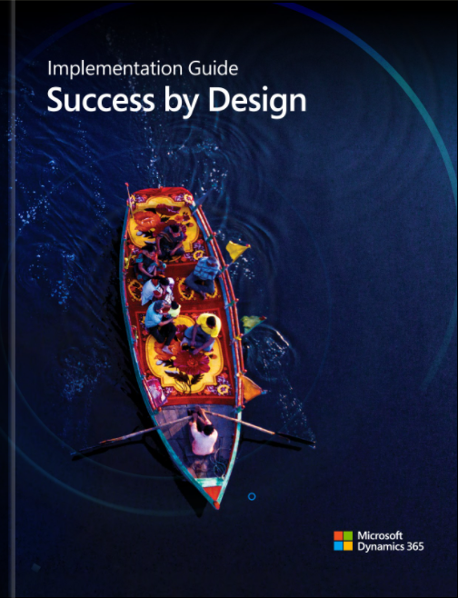
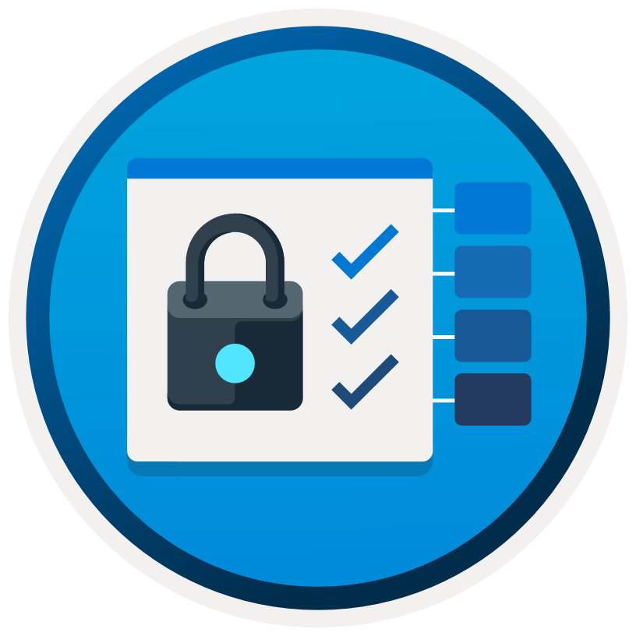
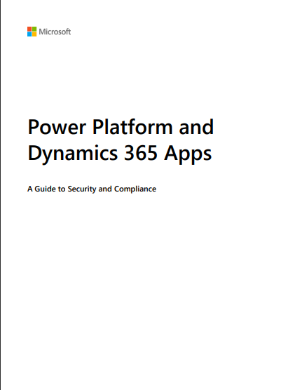
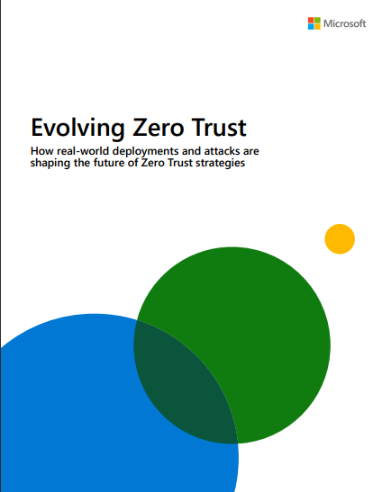
Resources
Dynamics 365 Implementation Guide
The “Environment strategy” chapter describes how environment-related decisions affect every aspect of the application, from application lifecycle management (ALM) to deployment and compliance. The “Security” chapter looks at the fundamental security principles applicable to Microsoft Dynamics 365 implementations.
https://aka.ms/D365ImplementationGuide/#p=192 and https://aka.ms/D365ImplementationGuide/#p=291
Success by Design: Security Strategy
Useful to review the security model for Dynamics 365 solutions.
https://docs.microsoft.com/learn/modules/fast-track-security/
Power Platform and Dynamics 365 Apps - Guide to security and compliance 2021
This document pulls together various information sources to provide an overview and underpinning details on
aspects related to Compliance, Privacy, Security and Transparency.
https://aka.ms/D365SecurityAndComplianceGuide
Embrace proactive security with Zero Trust
Real-world deployments and attacks are shaping the future of Zero Trust. Our framework, key trends, and maturity model can accelerate your journey.
https://www.microsoft.com/security/business/zero-trust
Notes:
There are a number of resources we recommend to go deeper into security.
The Dynamics 365 Implementation Guide has chapters on environment strategy and on security
There is a whole training module on Microsoft Learn on the Success by Design guidance for security.
The “Power Platform and Dynamics 365 Apps - Guide to security and compliance 2021” is a document pulls together various information sources to provide an overview and underpinning details on aspects related to Compliance, Privacy, Security and Transparency.
Last, the “Embrace proactive security with Zero Trust” whitepaper describes Microsoft’s framework on security.

Slide 32
Thank you
Notes:
Thank you

